Slide 1
SSID: AI IMMERSION
Password: MSFTWIFI

Slide 2

Tools for scaling using Azure
John-Mark Agosta, Principal Data Scientist Manager
Vanja Paunić, Data Scientist
Barbara Stortz, Principal SWE Manager
To start please go to this repository
http://tinyurl.com/AI-Immersion-ScalingR
Acknowledgements: Ali-Kazim Zaidi, Microsoft
Mario Inchiosa, Microsoft
Debraj GuhaThakurta, Microsoft

Slide 3
Session Goals
How to scale R code with distributed, parallel, and off-memory processing
How to develop scalable E2E R data-science process
How to easily operationalize code and models written in R
How to use cloud infrastructure (single node or clusters) to develop, scale, operationalize
Notes:
This slide is required. Do NOT delete. This should be the first slide after your Title Slide.
This slide should describe what your goals are for this session. This information lets your audience know what you are trying to accomplish with your talk or tutorial—ie, what value will attendees get by investing 25 minutes or 2 hours of their time listening to you.
You should not spend more than 1 minute presenting this slide.
General examples of session goals could be (you will have to create your own specific goals):
Introduce a new technique or approach to solve a customer problem
Compare two approaches and explain why one is superior
Describe a project and the learnings that audience members can apply from it
Teach audience members how to use a specific technology

Slide 4
Tutorial Outline
Intro to R [40 mins]
R language
IDEs for R
Libraries most used
R in the Cloud [50 mins]
Spark
Azure Batch
RevoScaleR, MicrosoftML, h2o
R deployment [50 mins]
Azure ML
R Server with SQL Server
mrsdeploy
4

Slide 5
Introduction
Linux
R language
IDEs for R
Libraries most used

Slide 6
Language
Platform
Open-source programming language for statistical computing
Originally designed by two University of Auckland Professors for their introductory statistics course, based on the S language from Bell Labs
A data visualization tool
Free
What is
Community
2.5+M users
Taught in most universities
Thriving user groups worldwide
5th in 2016 IEEE Spectrum rank
42% pro analysts prefer R (highest amongst R, SAS, python)
Ecosystem
10,000+ contributed packages and growing
Rich application & platform integration
Transparent and reproducible
6

Slide 7



A brief history of R
1977
1993
Research project in Auckland, NZ
2007
S
1997
R-core
2003
R Foundation
2009
New York Times
1995
Open source
2000
R-1.0.0
2004
First UseR!
2015
R-3.2.0
R Consortium
Photo credit: Robert Gentleman

Slide 8
We focus on one of many toolchains on Azure
language
interpreter
IDE
VM
deployment
AzureML
Mrsdeploy
Spark
MS SQL – R Server
H2O
Azure Batch
AzureML
Python
R
C#
Base R
MRO
MS R-Server
MS R-Client
Rgui
Rstudio
RTVS
Jupyter
ESS
Centos
Ubuntu
Windows
-

Slide 9
R Philosophy
R follows the Unix philosophy
Write programs that do one thing and do it well (modularity)
Write programs that work together (cohesiveness)
R is extensible with more than 10,000 packages available at CRAN (http://crantastic.org/packages)
9

Slide 10
Lazy evaluation in R
R, like its inspiration, Scheme, is a functional programming language. Iteration is discouraged, functions accept and return vectors by default.
R evaluates lazily, delaying evaluation until necessary, which can make it very flexible. Argument names are available to a function, to be used as labels.
R is a highly interpreted dynamically typed, object language, allowing you to mutate variables and analyze datasets quickly, but is significantly slower than statically typed languages like C or Java. But most computation is done by passing values to C libraries, which can be fast.
R has a high memory footprint, and can easily lead to crashes if you aren't careful. But the R-Server library (MRS) extends R to run disk-resident data, to run large datasets.
10

Slide 11
R Strengths and Weaknesses
Where R Succeeds
Expressive
Open source
Extendable -- nearly 10,000 packages with functions to use, and that list continues to grow
Focused on statistics and machine learning -- cutting-edge algorithms and powerful data manipulation packages
Advanced data structures and graphical capabilities
Large user community, both within academia and industry
It is designed by statisticians
Where R Falls Short
It is designed by statisticians
Inefficient at element-by-element computations
May make large demands on system resources, namely memory
Data capacity limited by memory
Single-threaded
11

Slide 12
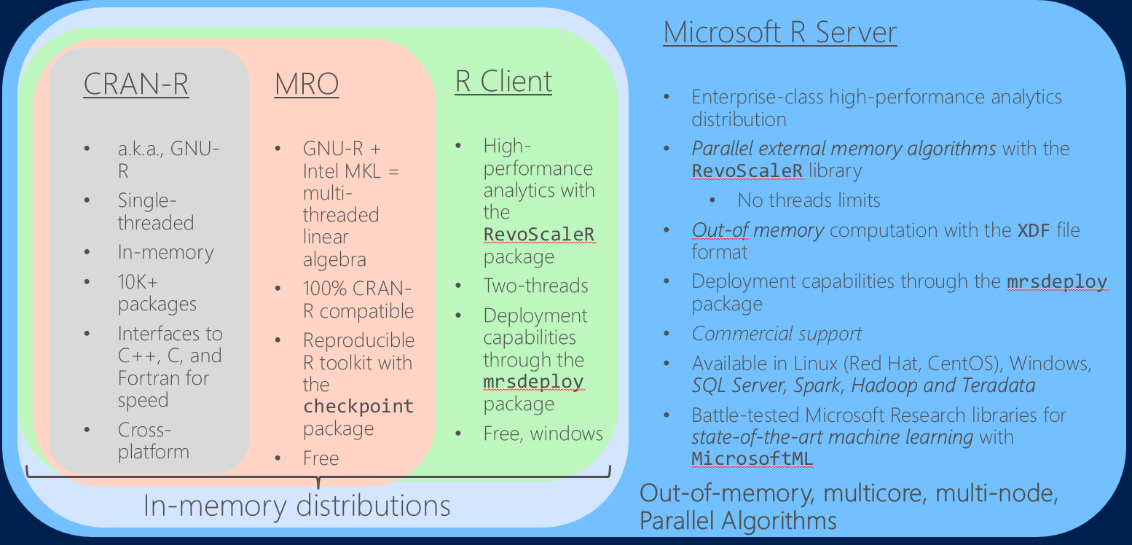
MS Distributions of R, compared to Open Source R
12

Slide 13
R IDEs
All distributions come with Rgui, a basic GUI editing and execution environment.
The most popular 3-rd party integrated development environment for R is Rstudio. The RStudio IDE is entirely html/javascript based, so completely cross-platform. RStudio Server provides a full IDE in your web browser: great for cloud instances
R Tools for Visual Studio, RTVS, now in V1, became generally available in 2016 for Windows machines. RTVS supports connectivity to Azure and SQL Server for remote connectivity
And more: Jupyter notebooks, Emacs + ESS, etc.
Of course batch and interpreter execution is possible from the command line.
13

Slide 14
Popular open source packages
There are over 10,000 R packages to choose from, what do I start with?
R and C++ Integration: Rcpp
Data Management (“tidy-verse”) : dplyr, tidyr, magrittr
Visualization: ggplot2, ggvis, htmlwidgets, shiny
Data Importing: haven, RODBC, readr, foreign
Other favorites: rmarkdown, caret
Also, essentially any statistics modeling function you can imagine.
14

Slide 15






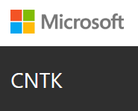


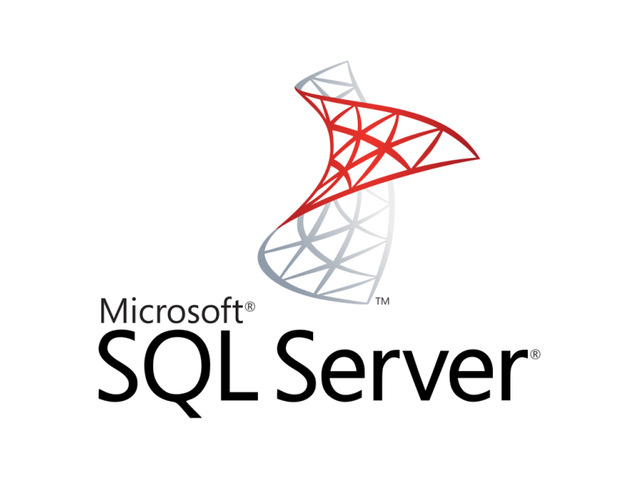



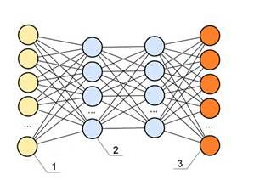

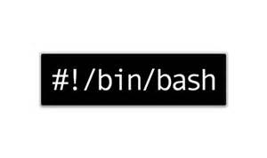



Explore algorithms and data with Azure Data Science VM
Contents of the Data-science Virtual Machine (DSVM)
Vowpal Wabbit
Spark 2.0.2
HDFS (local)
Yarn
More info at:
http://aka.ms/dsvm
xgboost
Rattle
Developer edition
CNTK
15

Slide 16
GitHub repository for all code and scripts
http://tinyurl.com/AI-Immersion-ScalingR
16

Slide 17
Good syntax to know
Assignment <-
Field selector $
Vector index [ ]
List index [[ ]]
Vector constructor c()
Transpose t()
Line comment #
Int value, e.g. 9L
Int series, e.g. 1:100
Binary ops, e.g. %in%
Help ?
Apropos ??
Scripts end in .r,.R
“Dot” is a valid symbol character
“underscore” – be careful
Semi-colon line endings are optional
{} are optional in one-line functions
as.<type>() are coercions
return() is optional
cat() works like print()
quit() ends a session

Slide 18
data.frame is the first class data structure
It’s a list() of column vectors, typically mixing different types e.g factor, double, etc.
It’s length()is the number of columns. (Use nrow() for the number of samples.)
Missing values have a special type, NA, which is different than the NULL type.
File I/O read and write data.frame types.
“R at scale” libraries specialize data.frame:
“tidyR”: data.table
SparkR: spark.data.frame
MRS: xdf (on disk)
Statisticians like data frames.

Slide 19
Hands on
Setup
R's data structures
Subsetting Operators
Vectors, Matricies
Lists, Data.Frames
dplyr
Manipulation verbs
Aggregation verbs
Magrittr, pipes
Functions and formulas
19

Slide 20
R in the Cloud
Spark
Azure Batch
R Server
20

Slide 21
Challenges posed by open source R
?
?
Limited Data Scale
Inadequate
Modeling Performance
Lack of Commercial Support
Complex Deployment
Processes
21
Notes:
Slide objective
Introduce how the use of open source R for machine learning and advanced analytics has been limited to a narrow user base of data scientists. Related to this, also discuss how many challenges and complexities remain for advanced analytics in the marketplace.
Talking points
Today, advanced analytics using open source R are being performed only by highly trained and specialized data scientists, mathematicians, and analysts who can create and nurture these models. This means that many challenges and complexities remain in the marketplace.
First, many companies cannot negotiate the increasing costs of specialized talent, infrastructure, and machine learning tools that make total cost of ownership (TCO) and return on investment (ROI) uncertain.
Second, siloed and cumbersome data management restricts access to data and poses limitations on what data can be included in models.
Third, trying to collaborate across complex and fragmented technologies tends to limit agility and reduce participation in exploring data and building models. People end up struggling with the technology instead of focusing on the business problem at hand.
Finally, many models never achieve business value because it’s so difficult to deploy them to stable production environments. If you can imagine spending hundreds of thousands of dollars on a solution and having it never go into production, you can see why machine learning has been so niche up to this point.

Slide 22
Scalable R solutions
R packages for distributed computing
SparkR
sparklyr
RevoScaleR (Microsoft R Server)
MicrosoftML (Microsoft R Server)
doAzureParallel
h2o
and more!
22

Slide 23
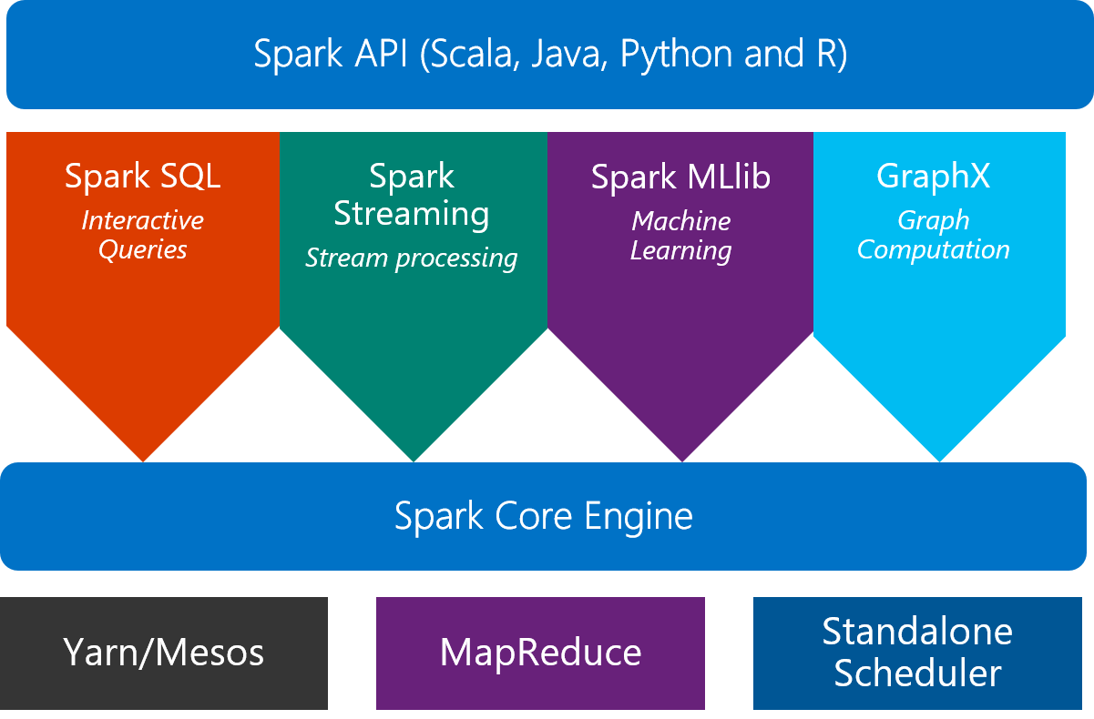
Spark
What is Spark?
An unified, open source, parallel, data processing framework for Big Data Analytics
23

Slide 24
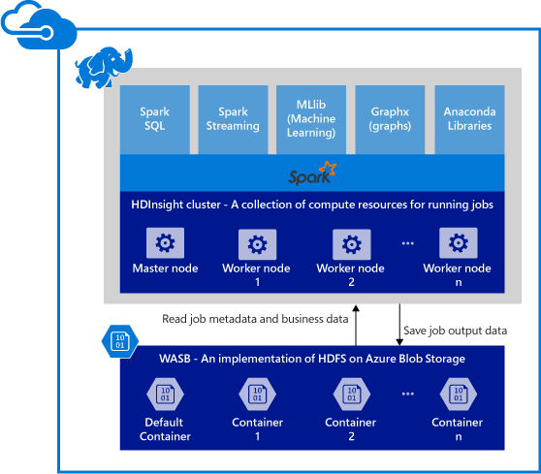
Spark clusters in Azure use HDInsight storage
Provisions Azure compute resources with Spark 2.0.2 installed and configured.
Supports multiple versions (e.g. Spark 1.6).
Stores data in Azure Blob storage (WASB), Azure Data Lake Store or Local HDFS.
24

Slide 25

SparkR: the Spark API in R
An R package provides a light-weight frontend to use Apache Spark from R and allows data scientists to analyze large datasets.
SparkDataFrame is distributed collection of data organized into named columns.
SparkR can create SparkDataFrames from local R data frames, csv, json and parquet files.
With Hive support, it can also access tables from Hive MetaStore.
Pre-configured on Spark clusters in Azure HDInsight.
25

Slide 26
SparkR: Data processing and modeling
Supports functions for structured data processing:
Selections: select, filter
Grouping, Aggregations: summarize, arrange
Running local R functions distributed: spark.lapply
Applying UDFs on each partition/group of a SparkDataFrame: dapply, dapplyCollect, gapply, gapplyCollect
Comes with MLlib to train models and allows model persistence.
Generalized Linear Model
Survival regression
Naive Bayes
KMeans
Logistic Regression
Gradient Boosted Tree
Random Forest
… others
26

Slide 27
RevoScaleR: scale-out R, enterprise class
100% compatible with open source R
Any code/package that works today with R will work in R Server.
Ability to parallelize any R function
Ideal for parameter sweeps, simulation, scoring.
Wide range of scalable and distributed rx pre-fixed functions in RevoScaleR package.
Transformations: rxDataStep
Statistics: rxSummary, rxQuantile, rxChiSquaredTest, rxCrossTabs…
Algorithms: rxLinMod, rxLogit, rxKmeans, rxBTrees, rxDForest…
Parallelism: rxSetComputeContext (rxExec)
Runs on Spark, Hadoop, SQL Server, Teradata
27

Slide 28

R Server + Azure HDInsight: Managed Hadoop for Advanced Analytics in the Cloud
R
Easy setup, elastic, SLA
Ubuntu Linux
Cloud Storage
Spark
R Server
Leverage R skills with massively scalable algorithms and statistical functions
Reuse existing R functions over multiple machines
SparkR functions
RevoScaleR functions
Spark and Hadoop
Blob Storage
Data Lake Storage

Slide 29
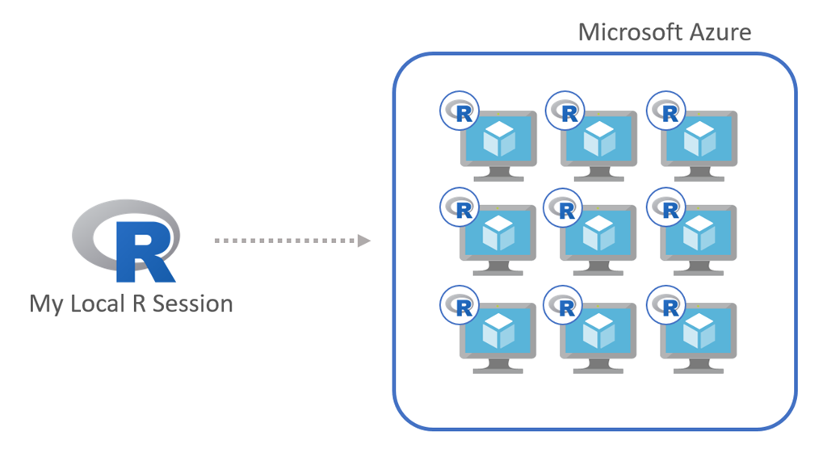
Azure Batch
doAzureParallel - a lightweight R package built on top of Azure Batch
doAzureParallel lets you execute multiple processes across a cluster of Azure virtual machines, from your local R session
In just a few lines of code, the package helps you create and manage a pool of Azure VMs, and register it as a parallel backend.
29

Slide 30
Hands on: SparkR and R Server
Airline delay prediction demo
30

Slide 31
Airline Arrival Delay Prediction Demo
Clean – Using SparkR from R Server
Train/Score/Evaluate – Scalable R Server functions
Deploy/Consume – Using mrsdeploy from R Server

Slide 32
Airline data set
Passenger flight on-time performance data from the US Department of Transportation’s TranStats data collection
>20 years of data
300+ Airports
Every carrier, every commercial flight
http://www.transtats.bts.gov

Slide 33
Weather data set
Hourly land-based weather observations from NOAA
> 2,000 weather stations
http://www.ncdc.noaa.gov/orders/qclcd/

Slide 34
R deployment
mrsdeploy
Azure ML
R Server with SQL Server
34

Slide 35


Microsoft R Server: mrsdeploy
Easy Consumption
Explore and consume services in R directly
Data Scientist
Easy Deployment
Turn R into web services in one line of code
Microsoft R Client
(mrsdeploy package)
Data Scientist
Services / Sessions
getService
Microsoft R Client
(mrsdeploy package)
publishService
Microsoft R Server
configured for
operationalizing R analytics
REST API calls
Easy Setup
In-cloud or on-prem
Adding nodes to scale
High availability & load balancing
Remote execution server
Apps
Easy Integration
Swagger-based APIs: easy to consume with any programming language
Developer
35

Slide 36

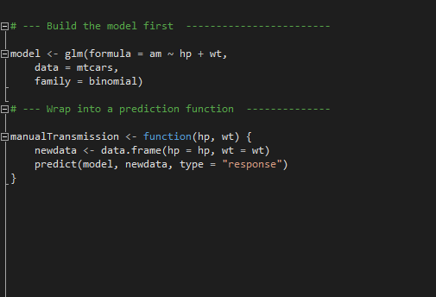
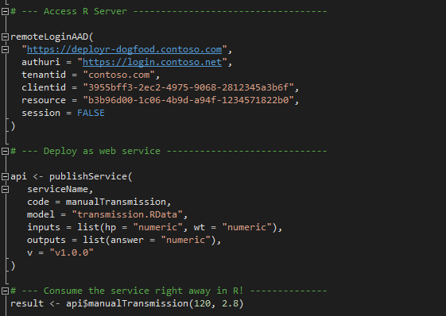
Microsoft R Server: mrsdeploy
Build the model first
Deploy as a web service instantly
https://msdn.microsoft.com/en-us/microsoft-r/operationalize/configuration-initial
https://msdn.microsoft.com/en-us/microsoft-r/operationalize/admin-utility
36

Slide 37
AzureML
AzureML: An R interface to AzureML experiments, datasets, and web services from your local R environment.
The main functions in the package cover:
Workspace: connect to and manage AzureML workspaces
Datasets: upload and download datasets to and from AzureML workspaces
Publish: define a custom function or train a model and publish it as an Azure Web Service
Consume: use available web services from R in a variety of convenient formats
37

Slide 38
SQL Server R Services
Simplicity and agility
Scalability and choice
Cost effectiveness
Enterprise speed and scale
Near-DB analytics
Parallel threading and processing
Reuse SQL skills for data engineering
In-database deployment
Memory and disk scalability
No R memory limits
Write once, deploy anywhere
Introduced in SQL Server 2016
Reuse and optimize existing R code
Eliminate data movement
Notes:
Slide objective
Introduce the three value proposition pillars of SQL Server 2016 R Services.
Talking points
SQL Server 2016 R Services brings the perfect mix of fast querying and In-Memory OLTP optimization from SQL Server 2016, as well as data exploration, predictive modeling, scoring, and visualization from the R Services family of products.
It delivers unprecedented enterprise speed and performance for advanced analytics, thanks to near-database analytics and parallel threading and processing.
It also delivers scalability and choice not seen before from a stable, commercial platform for advanced analytics. Its on-premises, cloud, and hybrid benefits, as well as its limits with large datasets, are unmatched.
Finally, there is no additional cost because the offering is included in SQL Server 2016. In addition, the ability to reuse existing R code and eliminate data movement across machines provides significant value.
Notes

Slide 39
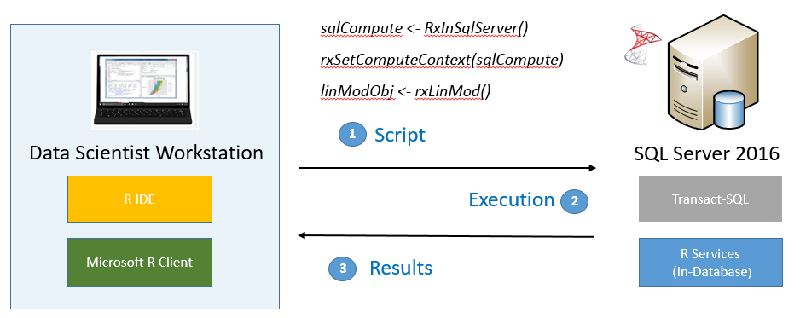
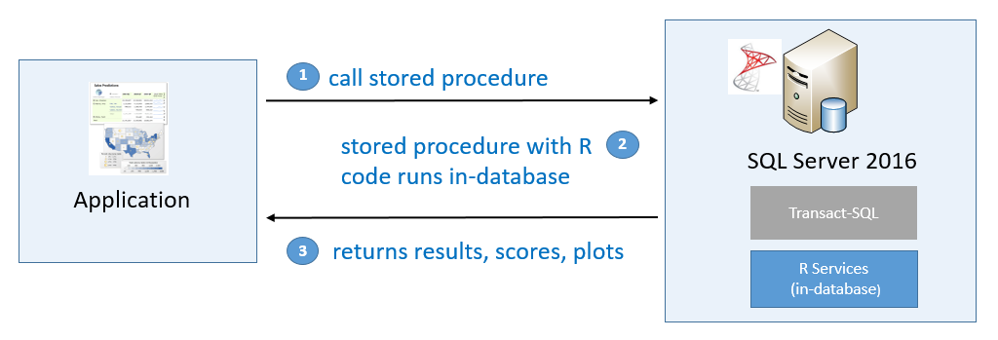
SQL Server R Services
Develop Your R (or Python) Solutions
Deploy and Consume
39

Slide 40
Hands on
mrdeploy: Airline delay prediction demo
AzureML
40

Slide 41
Q & A
41

Slide 42
Extras
42

Slide 43

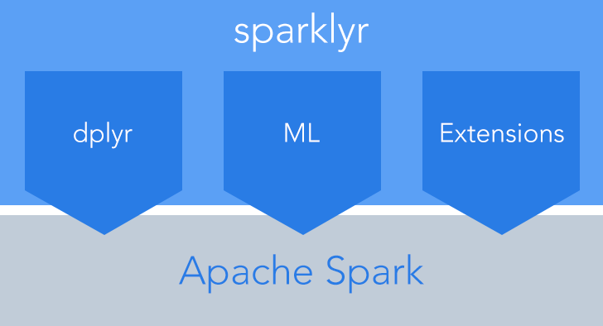
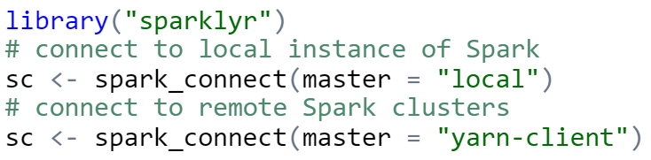
sparklyr: R interface for Apache Spark
Easy installation from CRAN
Connect to both local instances of Spark and remote Spark clusters
Loads data into SparkDataFrame from: local R data frames, Hive tables, CSV, JSON, and Parquet files.
Source: http://spark.rstudio.com/
43

Slide 44
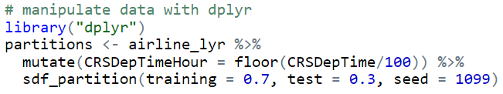
sparklyr: dplyr and ML
Provides a complete dplyr backend for data manipulation, analysis and visualization
%>%
Includes 3 family of functions for machine learning pipeline
ml_*: Machine learning algorithms for analyzing data provided by the spark.ml package.
K-Means, GLM, LR, Survival Regression, DT, RF, GBT, PCA, Naive-Bayes, Multilayer Perceptron, LDA
ft_*: Feature transformers for manipulating individual features.
sdf_*: Functions for manipulating SparkDataFrames.
44

Slide 45
Typical advanced analytics lifecycle
Prepare: Assemble, cleanse, profile and transform diverse data relevant to the subject.
Model: Use statistical and machine learning algorithms to build classifiers and regression models
Operationalize: Make predictions and visualizations to support business applications
Prepare
Model
Operationalize

